Slide 1
Passive Radar Detection
Student: Lewis Chambers
Supervisor: Vaughan Clarkson

Slide 2

Classic (active) Radar
Radio detection and ranging

Slide 3
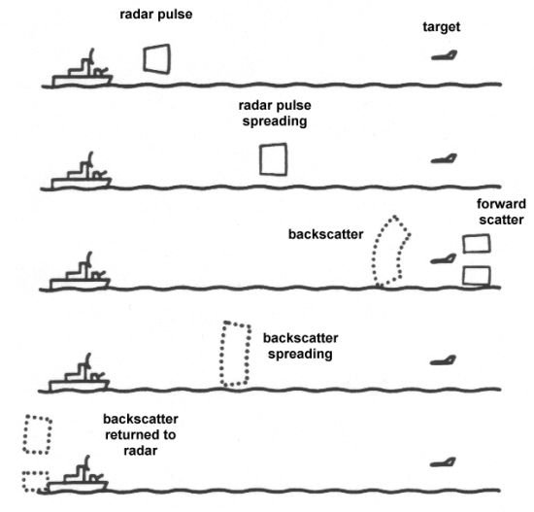
Classic (active) Radar

Slide 4
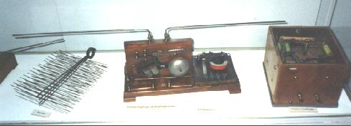
Classic (active) Radar
Telemobiloscope (1904)

Slide 5
Classic (active) Radar
Practical uses
Military
Aviation
Marine
Meteorology
Geology

Slide 6
Why passive?
Many advantages
Covert
Anti-Stealth
Immune to jamming
Cheap
Green

Slide 7
Why passive?
Passive is practical now because:
Computing power
DVB-T : wideband high-strength, high frequency signals

Slide 8
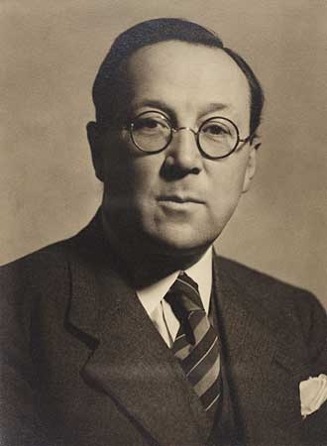
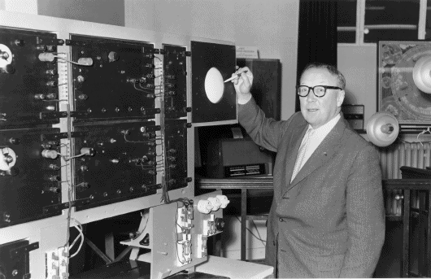
History
Sir Robert Watson-Watt

Slide 9
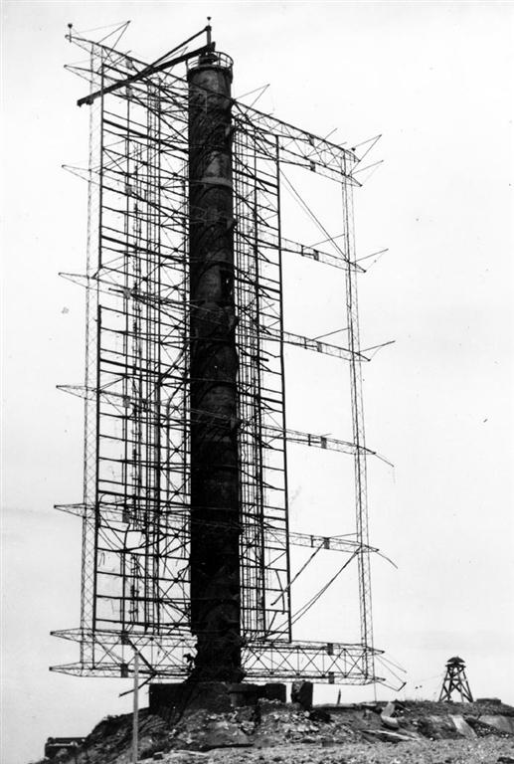
History
Klein Heidelberg

Slide 10
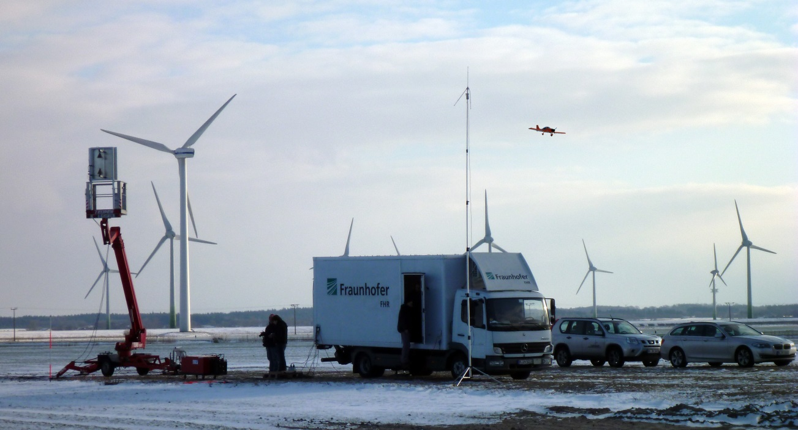
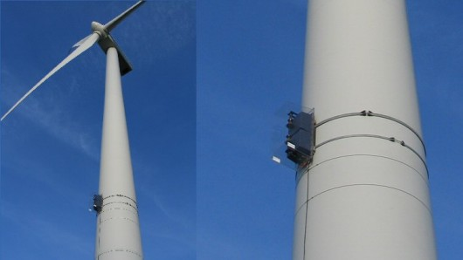
History of passive radar
PARASOL project

Slide 11
Passive detection
Signal models and scenarios:
Single receiver or multiple receiver
Using a single illuminator or multi-band/channel illuminators
Position of transmission source known vs unknown
Noise variance known vs unknown

Slide 12
Passive detection
Method for calculating position involves:
Correlation between each Tx-Rx pair for computation
Correlation between each Rx-Rx pair for computation
A combination of both

Slide 13
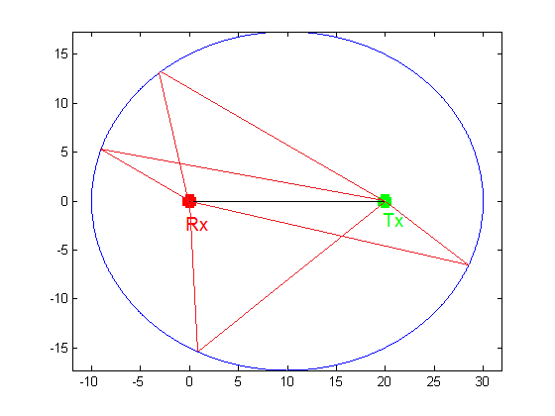
Simple Passive Cases

Slide 14
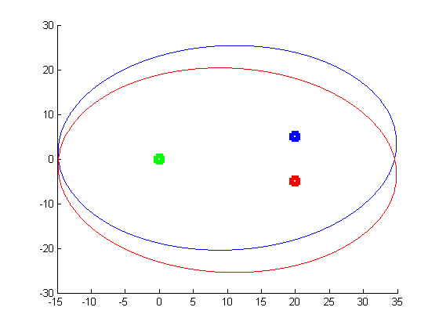
Simple Passive Cases

Slide 15
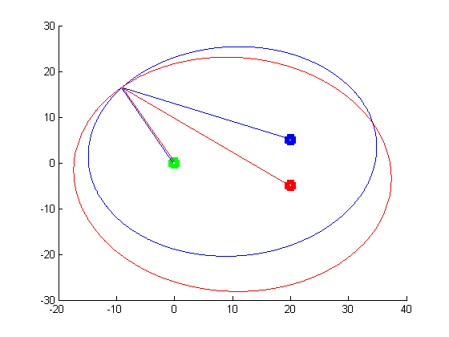
Simple Passive Cases

Slide 16
Passive Radar Theory
Assume a signal model
Guess location of target
From model, determine likelihood (probability) that target is actually there
If we do the guessing methodically (guess every point in a grid), we can get a likelihood map for the location of our targets

Slide 17
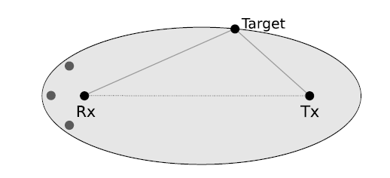
Signal Model
Tx generates signal s(t)
Rx receives target path signal x(t)

Slide 18
Signal Model

Slide 19
Signal Model

Slide 20


Signal Likelihood
This is where the methods differ
This approach is called Generalized Canonical correlation analysis (GCCA) [1]
For 2 receivers with a noise variance of σ², likelihood is given by
Maximized by setting:

Slide 21


Signal Likelihood
We then maximize this likelihood conditioned on s
After taking log of likelihood and comparing to null hypothesis and some simplification:
We want to maximize L(s|x₁, x₂), and the first 2 terms are constant

Slide 22

Signal Likelihood
Same as maximizing , where
Which is equal to the largest eigenvalue of
Which is equal to the largest eigenvalue of and is a 2x2 matrix

Slide 23
Signal Likelihood
So essentially, we are packing our corrected column vectors of received signals into a matrix Φ
Then compute G=Φ^{H}Φ
Then compute the largest eigenvalue of G
We do this for every position and velocity on our grid

Slide 24
Current Progress
Simulated in MATLAB
Can do detection over any range, at any resolution
Can simulate single transmitter at arbitrary location
Can simulate multiple receivers at arbitrary locations
Can simulate multiple static targets at arbitrary location
Can detect multiple static targets

Slide 25
Current Progress
Rx – 5 receivers, located at:
Origin
50m North, South, East and West of origin
Tx – 1 Transmitter, located 1000m East of origin
Target – 1 Target located 100m South and 100m West of origin
Simulate from (-200,-200) to (200,200), with a resolution of 1m

Slide 26
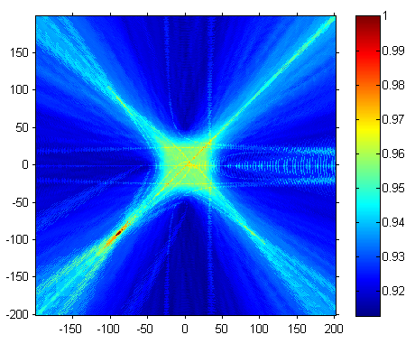
Current Progress

Slide 27
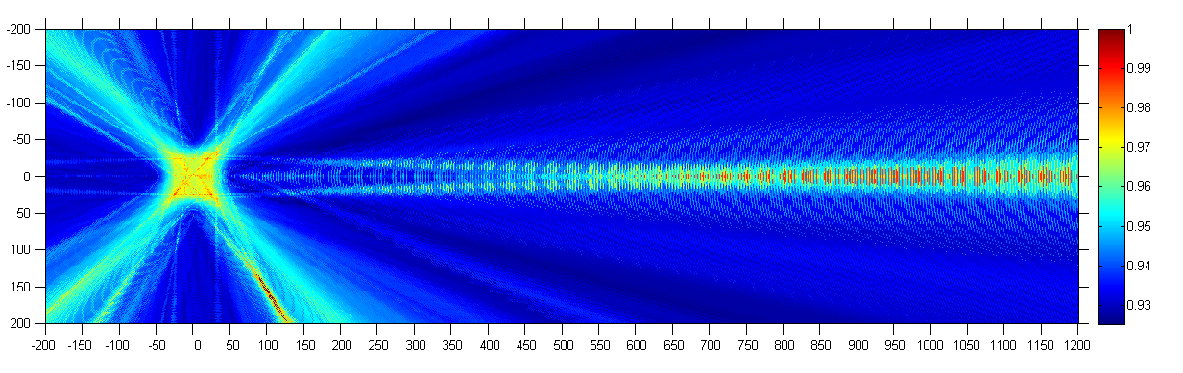
Current Progress
Different target location (100,150)
Extend so we can see transmitter

Slide 28
Current Progress
Multiple target detection
2 targets at (100,-150) and (20,100)
Auto-detect target locations

Slide 29
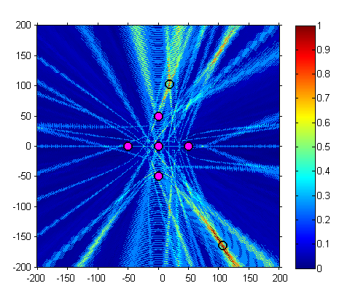
Current Progress

Slide 30
Next Steps
Incorporate frequency / Doppler shift to determine target velocity
Increase algorithm efficiency
Remove original signal (cleaner results)
Incorporate Radar Cross Section
Test over range of frequencies
Test over range of distances
Test over range of number of samples

Slide 31
Thesis Plan
Finish case: Single Tx, multiple Rx with GCCA
Simulate and code algorithm for case: Single Rx, multiple Tx, using Bayesian detection and Generalized ration likelihood test (GLRT)
Simulate and code algorithm for case: Multiple Rx, multiple Tx, all Rx and Tx stationary using source localization
Simulate and code algorithm for case: Multiple Rx, multiple Tx, Tx or Rx could be moving (i.e. an antenna attached to a plane)

Slide 32
Thesis Plan
Compare the above 4 methods
Generate my own method for solving the passive coherent location problem

Slide 33
References
[1] K. S. Bialkowski, I. V. L. Clarkson, and S. D. Howard, "Generalized canonical correlation for passive multistatic radar detection," 2011, pp. 417-420.

Slide 34
Questions?

